Slide 1
Predicting Ethereum
A study into the future value of Cryptocurrency
John Neville
Regis University
https://github.com/DSNeville/Practicum

Slide 2

What is Ethereum?
Digital Currency or network for transactions
A means to securely store data
Data that holds monetary value
Transactions stored in decentralized ledger
Blockchain – visible to all
Digital Wallet

Slide 3
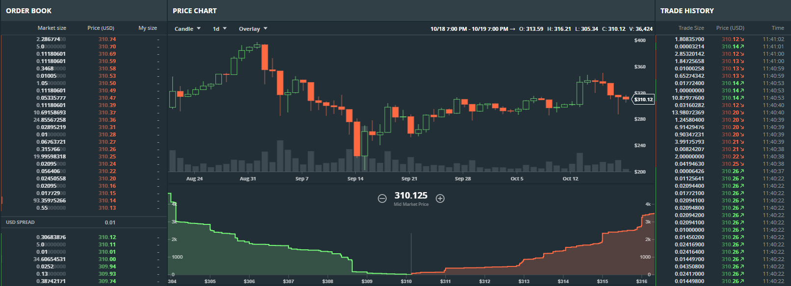
How do you determine the value of Etheruem?
https://www.gdax.com/trade/ETH-USD

Slide 4

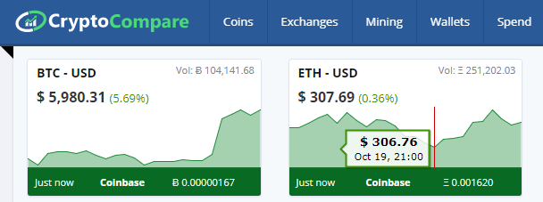


Getting the Data – API’s

Slide 5
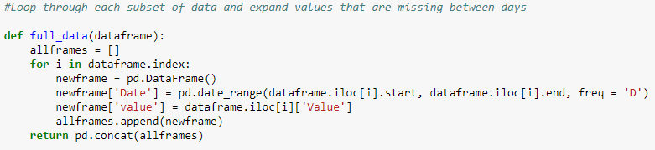
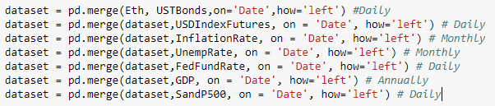


Data Engineering
Dealing with monthly vs daily values
Adding lagged values for regression

Slide 6
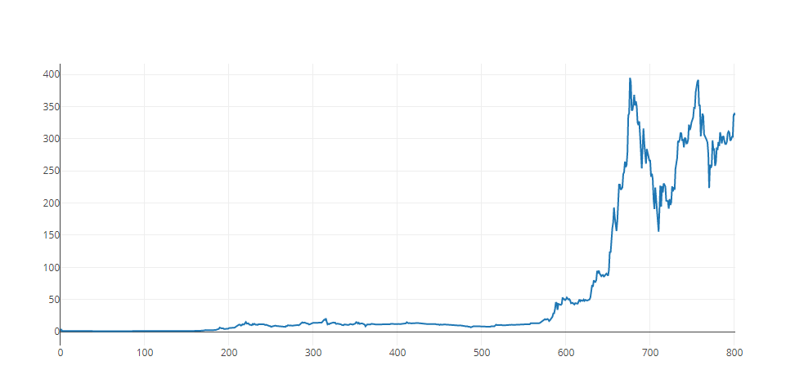
Getting A Sense on Ethereum Open Values
Comes to life in Feb 2017 (just under 600 to the right)
High growth occurring end of May 2017
High volatility in 2017

Slide 7

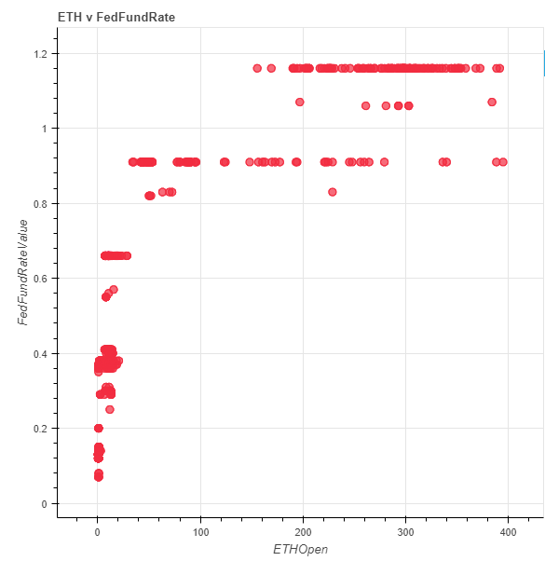

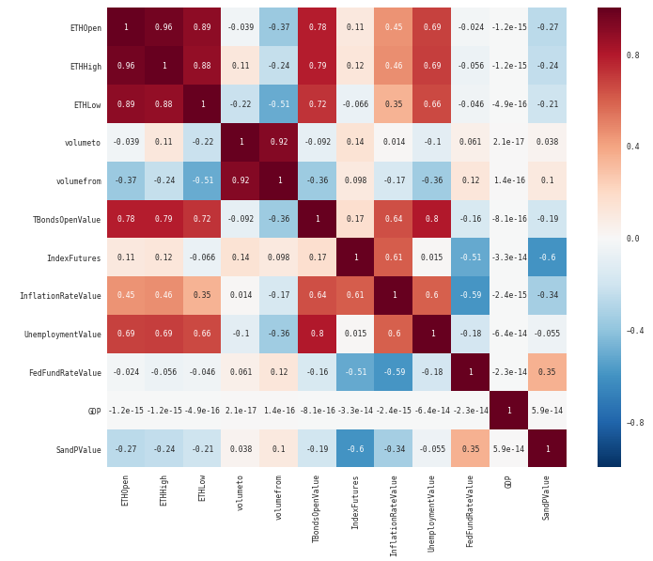


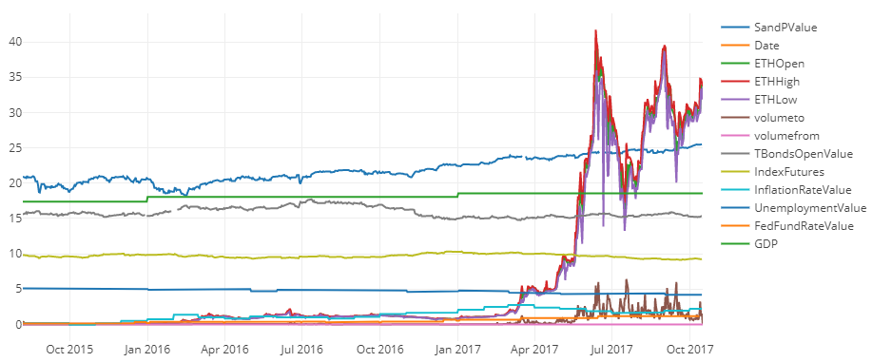
Exploratory

Slide 8
Models To Evaluate
ARIMA
FBProphet – Timeseries analysis, software provided by Facebook
Linear Regression
Ridge Regression
Lasso Regression
XGB Boost – Linear Regression

Slide 9
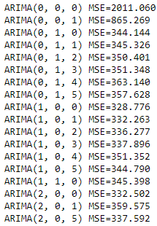
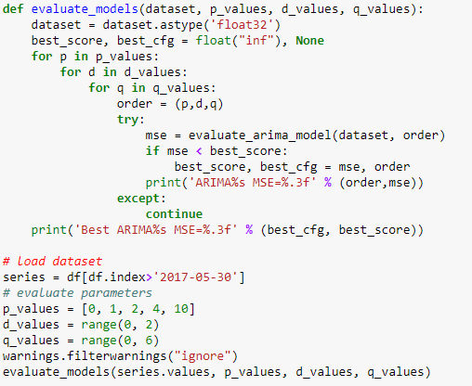
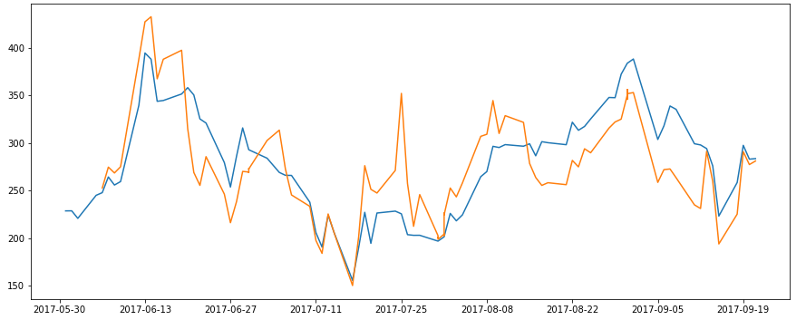
Arima Model
Model Tuning Using Iteration:
ARIMA(p,d,q)
p = number of autoregressive terms to use
d = number of differences to achieve stationary data (required)
q = number of lagged forecast error

Slide 10
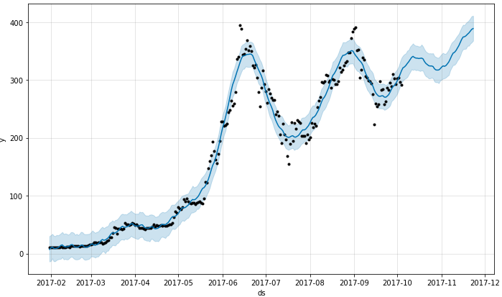
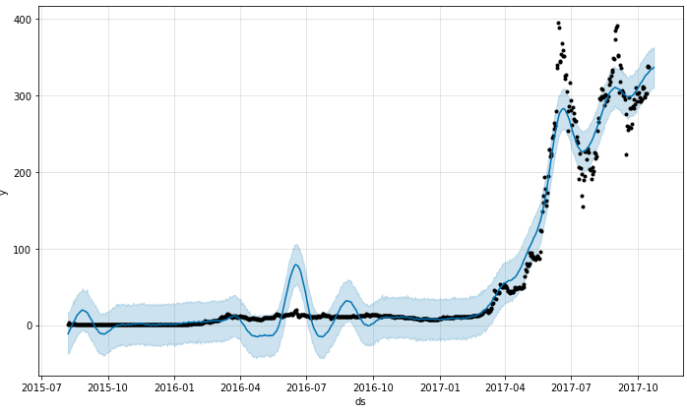
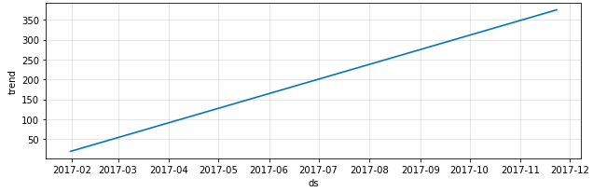
FBProphet
This Year Only:
Not as inflated
All Data:
High Forecasts
Trend:

Slide 11
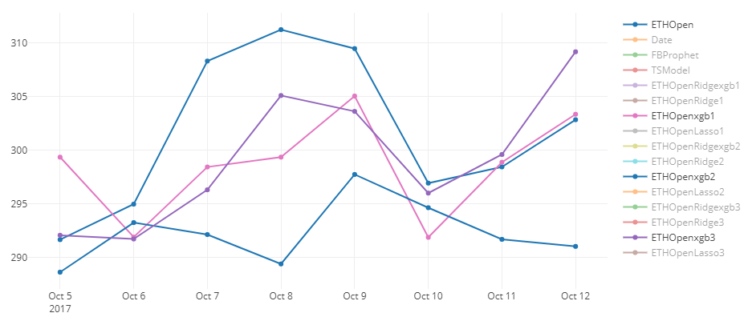
Linear Regression
xgb Boost
Resamples data to get best fit
Avoids overfitting

Slide 12
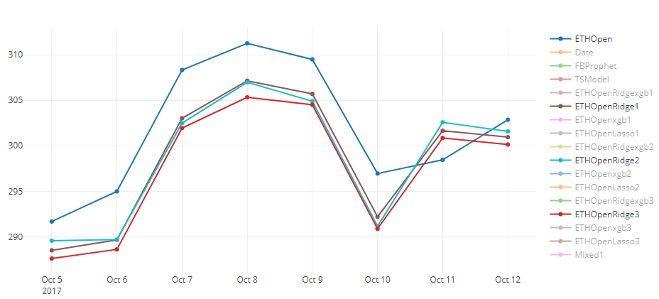
Ridge Regression
Lower magnitude of coefficients
Helps with multicollinearity
Requires alpha tuning

Slide 13
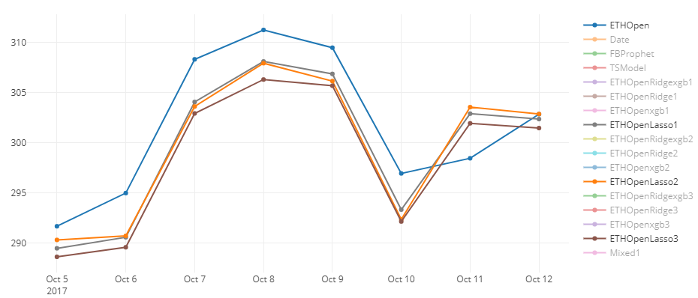
Lasso Regression
Least Absolute Shrinkage Selector Operator
Automatic feature selection
Requires alpha tuning

Slide 14
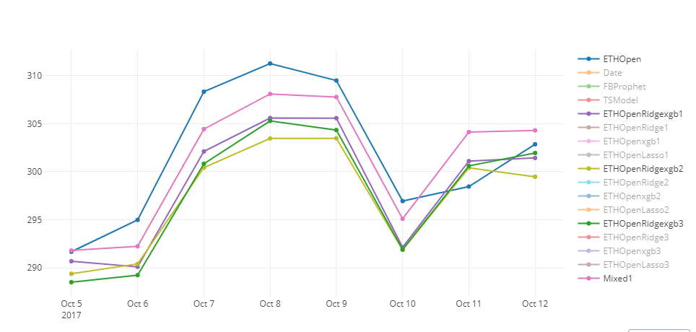
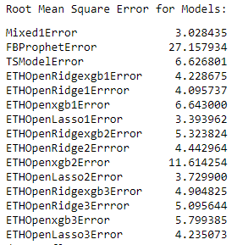
Model Evaluation
Mixed Models
Attempt to account for seasonal trends from timeseries
Account for boosted regression
Account for collinearity

Slide 15
Results
Winning Formula = (FinalResults.FBProphet*.05) + (FinalResults.ETHOpenLasso1*.85) + (FinalResults.ETHOpenxgb1 *.1)
Continued Research
Elastic Net Regression
Neural Network
News Scrubbers (Sentiment) – High Dependency on news of regulation or technical improvements and shortfalls
More Features

Slide 16
Thank you! Questions?
For resources please see the Github repository:
https://github.com/DSNeville/Practicum

